Slide 1

Lesson 3: OOP

Slide 2
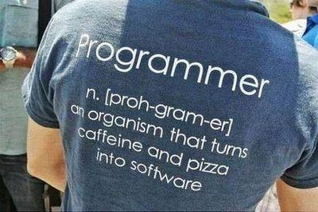
Lesson goals
Programming history
OOP
Principles of OOP
Classes, objects and methods
Interface and Abstract Class
Homework

Slide 3
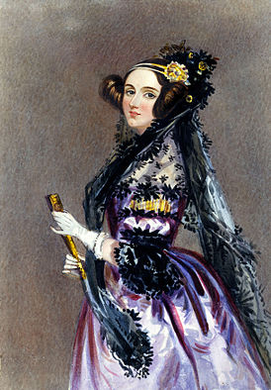
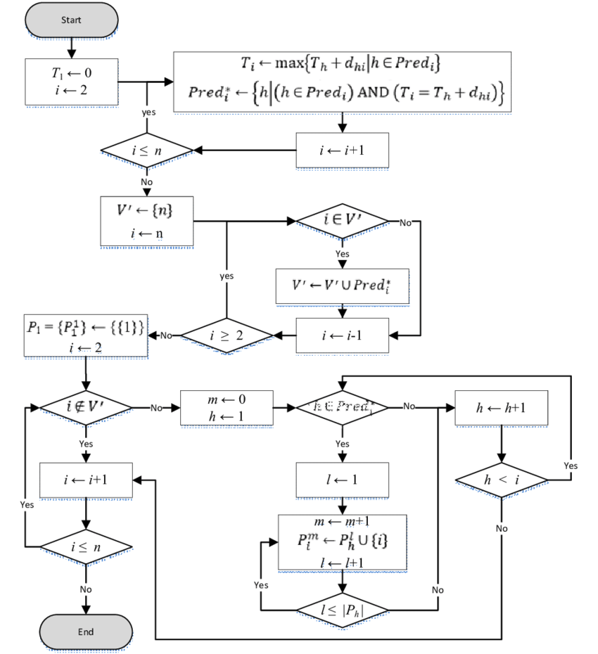
Algorithm
Augusta Ada King, Countess of Lovelace
She was the first to recognise that the machine had applications beyond pure calculation, and to have published the first algorithm intended to be carried out by such a machine. As a result, she is often regarded as the first computer programmer.

Slide 4
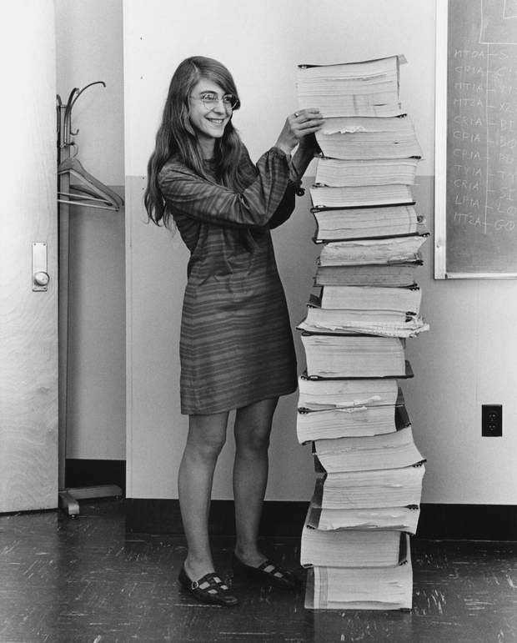
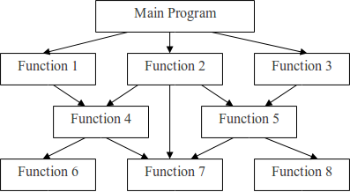
Procedural programming
Margaret Hamilton
She developed on-board flight software for NASA's Apollo program.

Slide 5
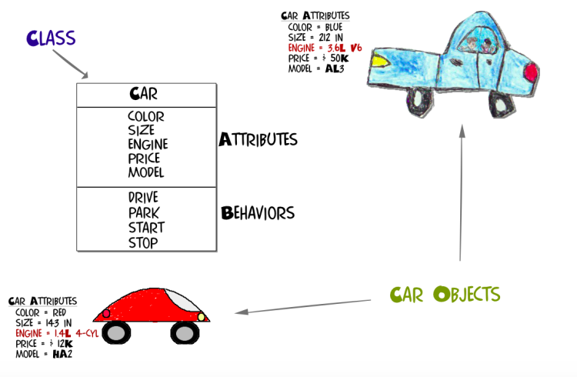
Object-oriented programming
Object-oriented programming (OOP) is a programming paradigm based on the concept of "objects", which can contain data and code: data in the form of fields (often known as attributes or properties), and code, in the form of procedures (often known as methods).

Slide 6
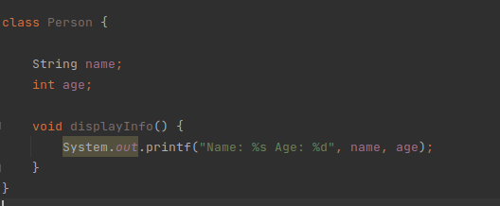
Class
In object-oriented programming, a class is an extensible program-code-template for creating objects, providing initial values for state (member variables) and implementations of behavior (member functions or methods)

Slide 7
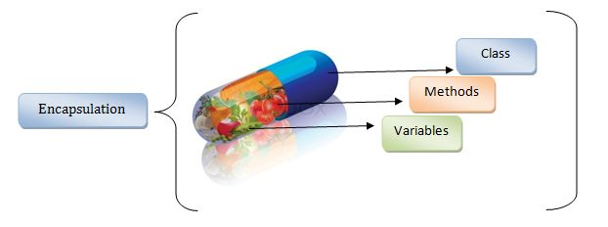
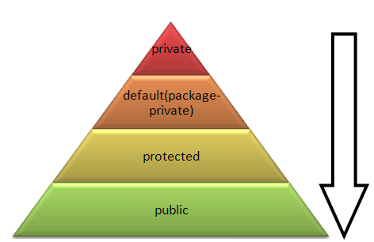
Encapsulation
Encapsulation is one of the fundamentals of OOP (object-oriented programming). It refers to the bundling of data with the methods that operate on that data. Encapsulation is used to hide the values or state of a structured data object inside a class, preventing unauthorized parties’ direct access to them. Publicly accessible methods are generally provided in the class (so-called getters and setters) to access the values, and other client classes call these methods to retrieve and modify the values within the object

Slide 8
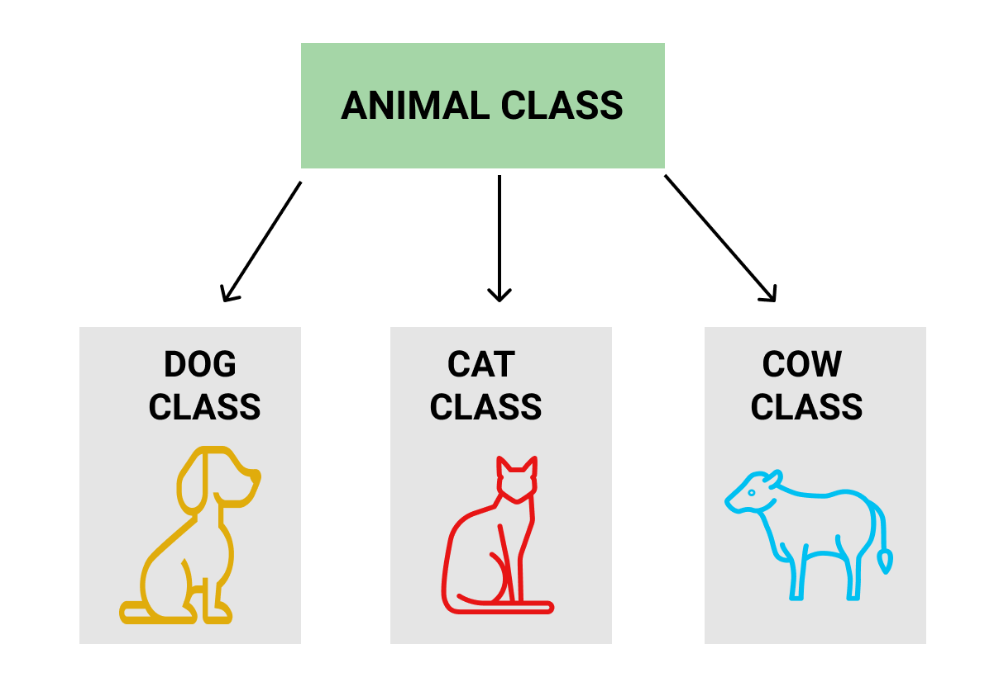
Inheritance
Inheritance is the mechanism of basing an object or class upon another object (prototype-based inheritance) or class (class-based inheritance), retaining similar implementation. Also defined as deriving new classes (sub classes) from existing ones such as super class or base class and then forming them into a hierarchy of classes.

Slide 9
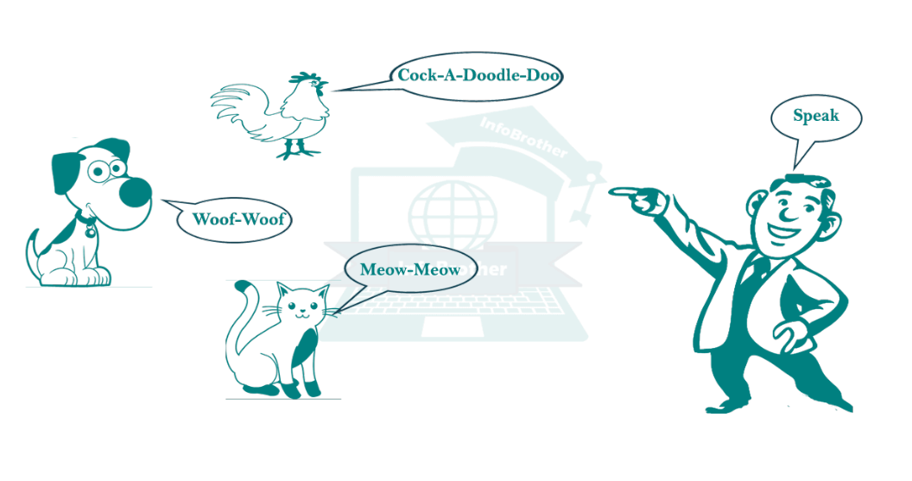
Polymorphism
Polymorphism is the provision of a single interface to entities of different types or the use of a single symbol to represent multiple different types. The concept is borrowed from a principle in biology where an organism or species can have many different forms or stages.

Slide 10
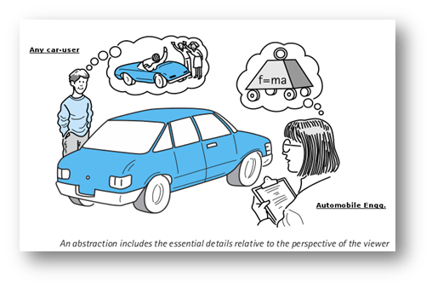
Abstraction
The process of removing physical, spatial, or temporal details or attributes in the study of objects or systems to focus attention on details of greater importance; it is similar in nature to the process of generalization;
the creation of abstract concept-objects by mirroring common features or attributes of various non-abstract objects or systems of study – the result of the process of abstraction.

Slide 11
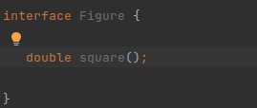
Interface
An interface in the Java programming language is an abstract type that is used to specify a behavior that classes must implement. They are similar to protocols. Interfaces are declared using the interface keyword, and may only contain method signature and constant declarations (variable declarations that are declared to be both static and final). All methods of an Interface do not contain implementation (method bodies) as of all versions below Java 8.

Slide 12
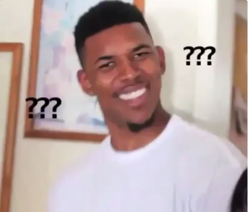
Any questions?

Slide 13
Literature
Books:
“The Complete Reference” by Herbert Schildt (chapter 6-9)

Slide 14
Homework
Task
Implementation of a console program for comparing two geometric shapes with a demonstration of OOP capabilities and OOP principles
Minimum requirements:
- the presence of an interface with a default implementation;
- the presence of an abstract class;
- shape construction parameters are entered from the keyboard;
- if incorrect data is entered, the program does not stop its work
- the possibility to paint the figure with color if desired

Slide 15
Homework
Acceptance criteria:
Given: the application is implemented
When: When the user starts the application
Then: the program prompts the user to select the first form
When: when the user selected the required shape (circle, triangle, square, rectangle)
Then: the program prompts the user to enter the necessary parameters of the form to build it
When: When the user enters the required data to build the form
Then: the program prompts the user to choose the color of the shape
When: When the user has not selected any color for the shape
Then: The shape will be black by default
When: When the user has entered all the required data for both shapes
Then: the program compares two figures and outputs the necessary information in the format:
figure 1:
- a rectangle
- area - 7.8
- perimeter - 12
- color - yellow
figure 2:
- a triangle
- area - 5.3
- perimeter - 8.1
- color - black
figure 1 is bigger than figure 2
When: When at any stage the user enters invalid data
Then: the program shows a corresponding message and asks to repeat the input.

Slide 16
Thanks!
Find us in Slack:
@Bohdan Cherniak
@Vladyslav Nikolenko
@Volodymyr Vedula

